Slide 1
Advanced Data Augmentation Strategy for Neural Machine Translation
Zhirui Zhang
University of Science and Technology of China (USTC)
Notes:
大家好，我叫张志锐，是中国科学技术大学博士生，也在MSRA的联合培养项目里面，所以我有两个导师，陈恩红和沈向洋，今天很高兴能在这里介绍我的一些研究工作。今天演讲的主题是“”
Hi every, today I will introduce

Slide 2
Outline
NMT Overview
Advanced Data Augmentation Strategy
Iterative Back-Translation (Semi-supervised NMT)
Target-bidirectional Agreement Regularization (Supervised NMT)
SMT as Posterior Regularization (Unsupervised NMT)
Summary
Notes:
在这个讲座里面，我首先会简单介绍一下NMT的历史，然后在仔细介绍我的三个数据增强方法

Slide 3
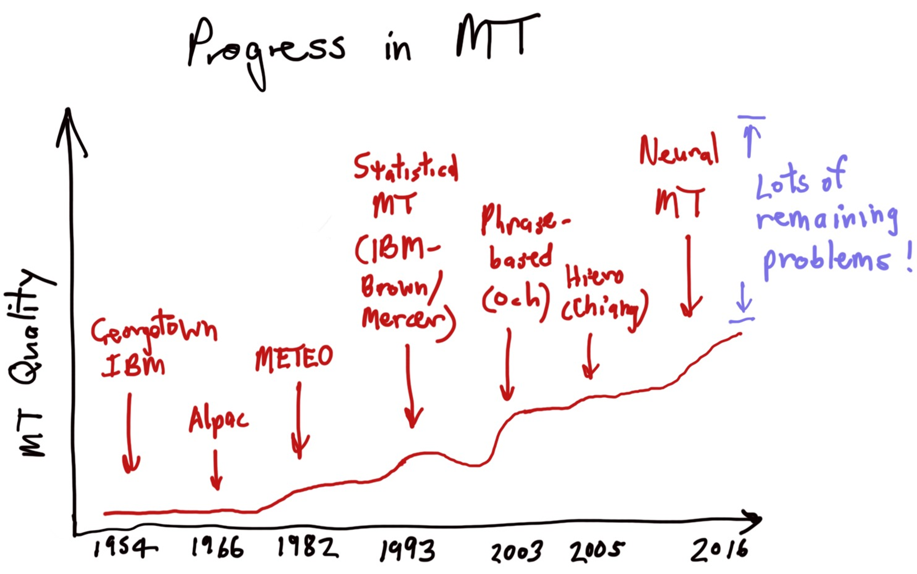
History
NMT Overview | Iterative Back-Translation | Agreement Regularization | SMT as Posterior Regularization | Summary
2016 - Near Parity (Google)
2018 – Human Parity (Microsoft)
From [https://nlp.stanford.edu/projects/nmt/Luong-Cho-Manning-NMT-ACL2016-v4.pdf]

Slide 4

Neural Machine Translation
NMT Overview | Iterative Back-Translation | Agreement Regularization | SMT as Posterior Regularization | Summary
$y$=(近, 几年, 经济, 发展, 变, 慢, 了, .)
Decoder
Attention
Attention
Weight
$$⨀$$
$$⊕$$
Encoder
$x$=(Economic, growth, has, slowed, down, in, recent, years,.)
[Cho et al. 2014; Sutskever et al. 2014; Bahdanau et al. 2015]

Slide 5
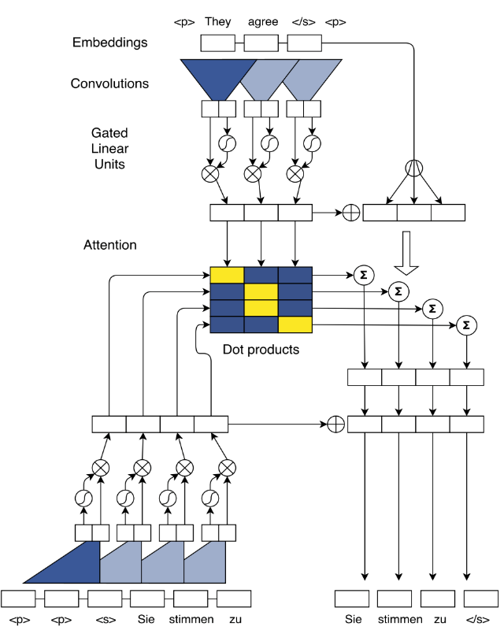

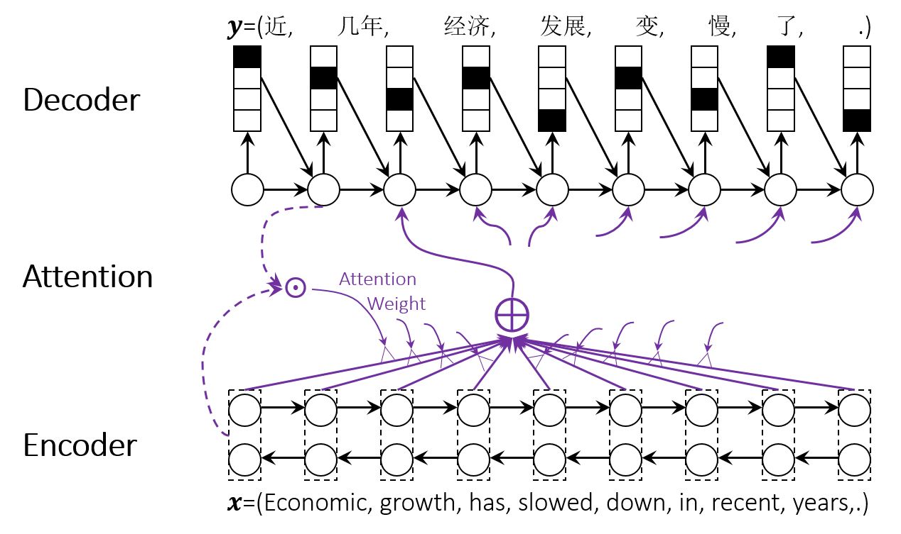
Neural Machine Translation
NMT Overview | Iterative Back-Translation | Agreement Regularization | SMT as Posterior Regularization | Summary
Rely on large high-quality parallel data
ConvS2S (Facebook)
Transformer (Google)

Slide 6
Data Augmentation
NMT Overview | Iterative Back-Translation | Agreement Regularization | SMT as Posterior Regularization | Summary
Data augmentation algorithms generate extra data points from the empirically observed training set to train subsequent machine learning algorithms
Data augmentation techniques are widely used in computer vision
Data augmentation + NMT?
Data augmentation + Semi-supervised NMT → Iterative Back-Translation
Data augmentation + Supervised NMT → Agreement Regularization
Data augmentation + Unsupervised NMT → SMT as Posterior Regularization
Notes:
In computer vision, data augmentation techniques are widely used to increase robustness and improve learning of objects with a limited number of training examples.

Slide 7
Monolingual Training Data
NMT Overview | Iterative Back-Translation | Agreement Regularization | SMT as Posterior Regularization | Summary
Why monolingual data for NMT?
Easy to collect and more diverse
More training data
Solutions
Deep fusion (Gulcehre et al. 2015)
Auto-Encoder (Cheng et al. 2016)
Back-Translation (Sennrich et al. 2016)
…

Slide 8
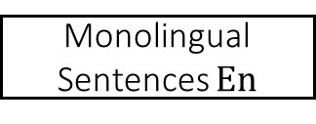
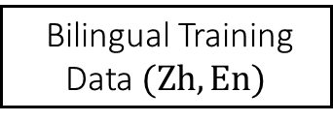
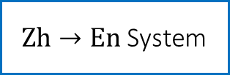
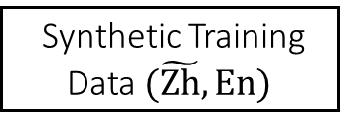

Motivation
NMT Overview | Iterative Back-Translation | Agreement Regularization | SMT as Posterior Regularization | Summary
Back-translate target monolingual data into source language
Bilingual Training Data $(Zh,En)$
Bad pseudo sentence pairs hurt the performance.
Only the target monolingual data can be leveraged.
Target to source translation model is not optimized.
Monolingual Sentences $En$
$En→Zh$ System
$Zh→\text{En}$ System
Synthetic Training Data $(\tilde{Zh},En)$
Notes:
Since model parameters of NMT have to be learnt with fully labeled data, monolingual data cannot be directly applied to model training. Back-translation fills the gap between requirement for parallel data and availability of monolingual data in NMT.
Specially , given a set of sentences y in target language, a pre-constructed target-to-source NMT system is used to generate their translation. Then the synthetic data are used as additional parallel data to train the source-to-target NMT model, together with original bilingual data.

Slide 9
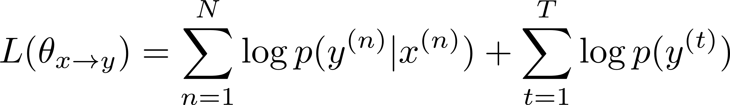
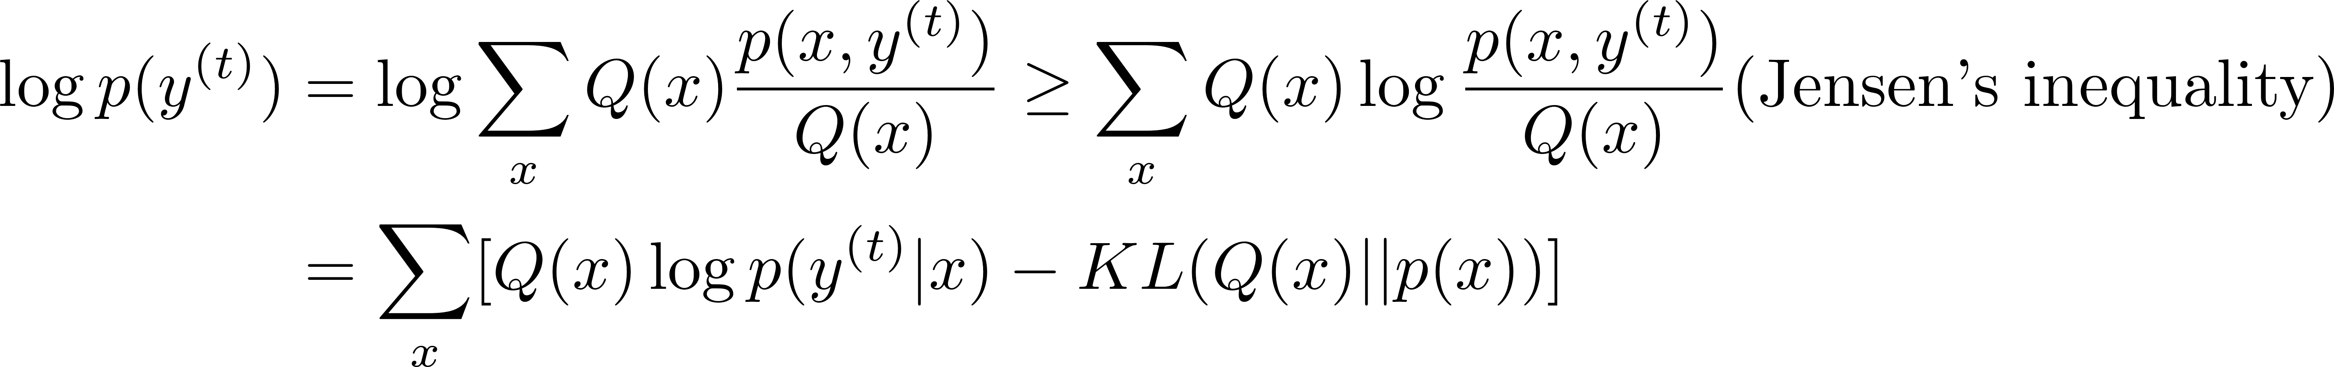
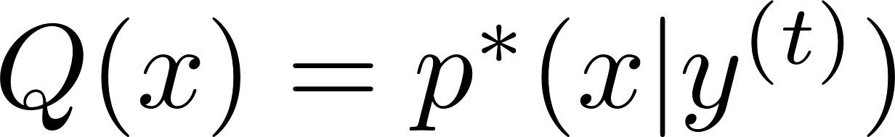
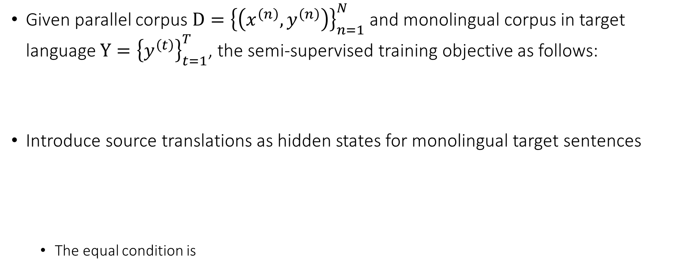
Training Objective
NMT Overview | Iterative Back-Translation | Agreement Regularization | SMT as Posterior Regularization | Summary
Given parallel corpus $D={\left\{\left(x^{\left(n\right)},y^{\left(n\right)}\right)\right\}}_{n=1}^{N}$ and monolingual corpus in target language $Y={\left\{y^{\left(t\right)}\right\}}_{t=1}^{T}$, the semi-supervised training objective as follows:
Introduce source translations as hidden states for monolingual target sentences
The equal condition is

Slide 10
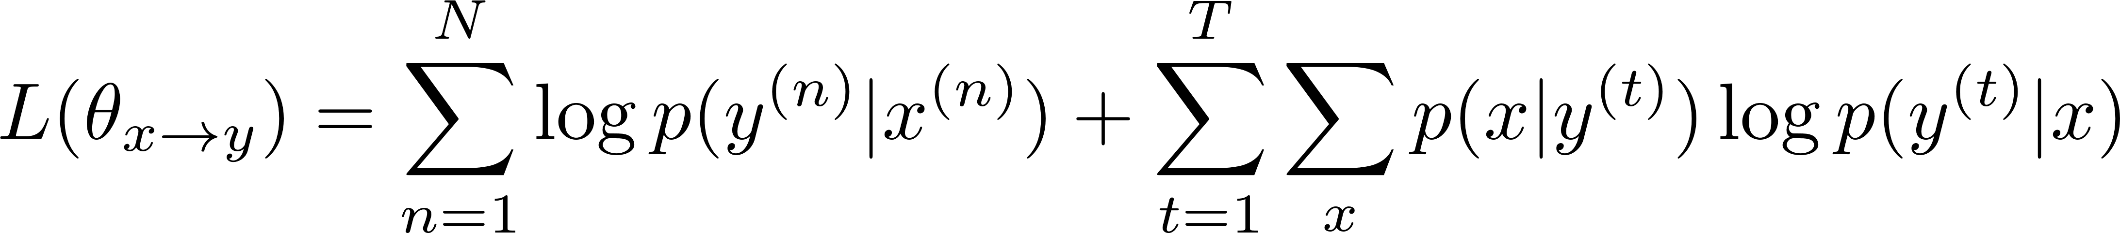
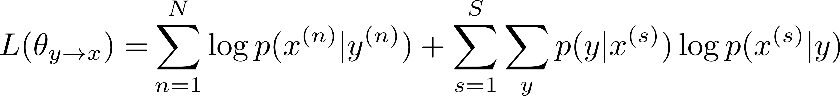
Training Objective
NMT Overview | Iterative Back-Translation | Agreement Regularization | SMT as Posterior Regularization | Summary
The semi-supervised training objective can be simplified as
The inverse direction translation is similar
The overall training objective is the sum of likelihood in both directions
back-translation method

Slide 11
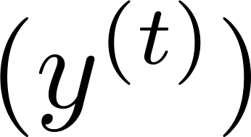
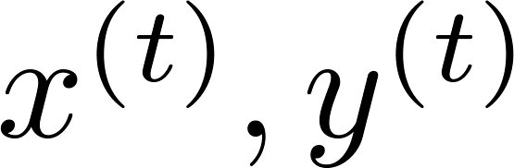
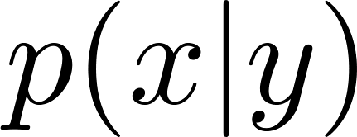
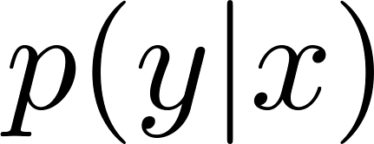
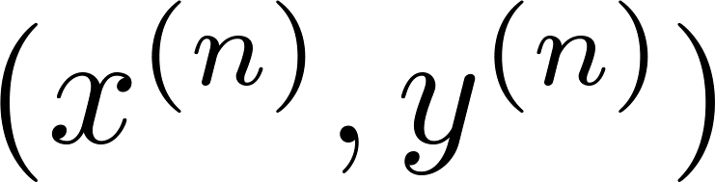
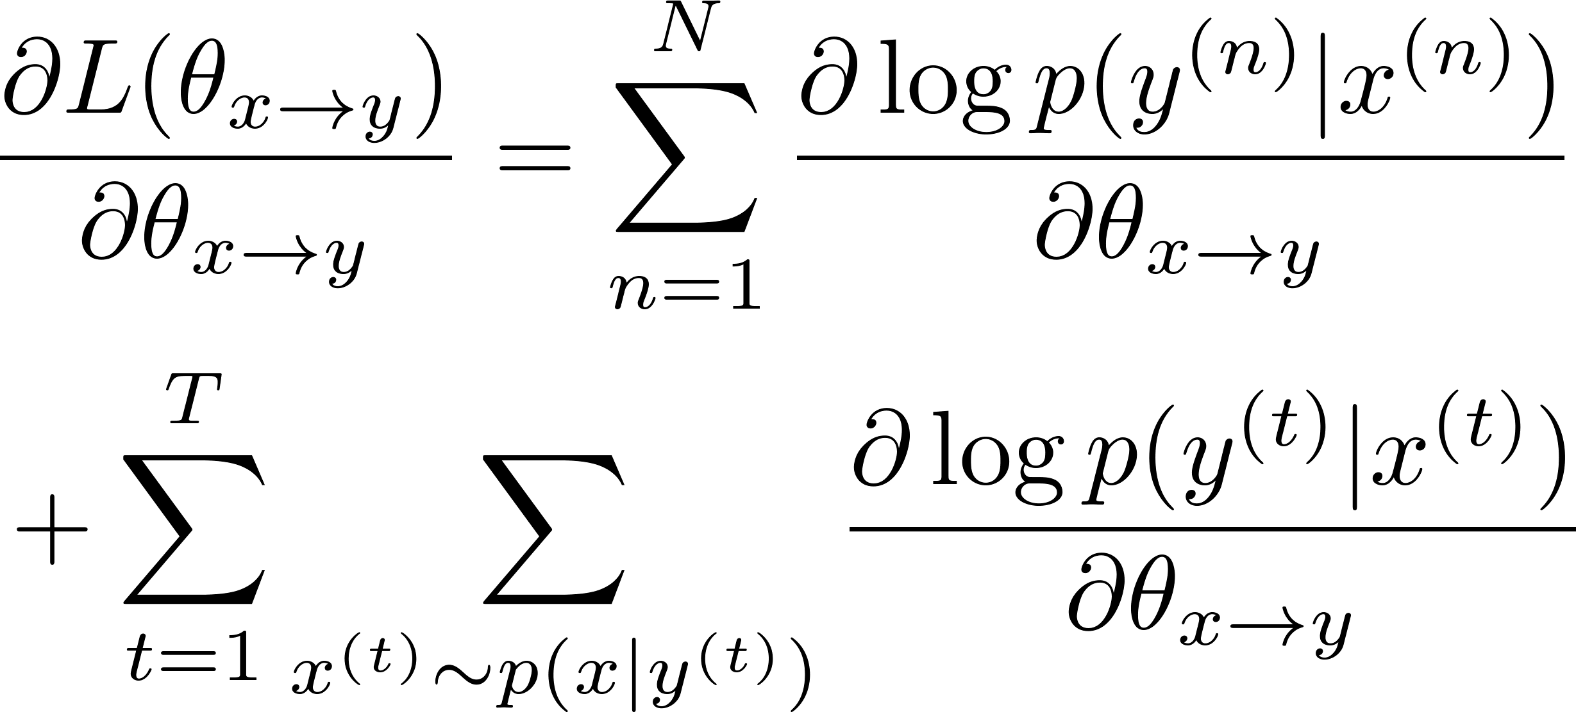
Iterative Back-Translation (T2S → S2T)
NMT Overview | Iterative Back-Translation | Agreement Regularization | SMT as Posterior Regularization | Summary
Target Data
Pseudo Data
Sampling
2
T2S Model
Bilingual Data
S2T Model
1
1
2

Slide 12
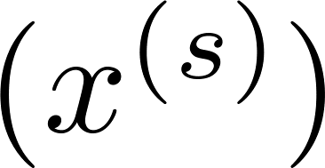
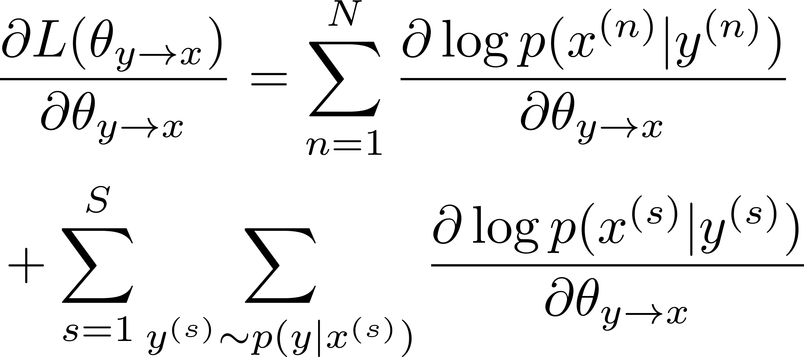
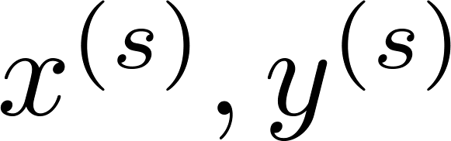
Iterative Back-Translation (S2T → T2S)
NMT Overview | Iterative Back-Translation | Agreement Regularization | SMT as Posterior Regularization | Summary
Target Data
Pseudo Data
Source Data
Sampling
2
T2S Model
Bilingual Data
S2T Model
1
1
2
Sampling
1
1
Pseudo Data
2
2

Slide 13
Iterative Back-Translation (Joint Training)
NMT Overview | Iterative Back-Translation | Agreement Regularization | SMT as Posterior Regularization | Summary
Target Data
Pseudo Data
Source Data
Sampling
2
T2S Model
Bilingual Data
S2T Model
1
1
2
Sampling
1
1
Pseudo Data
2
2

Slide 14
Experiment
NMT Overview | Iterative Back-Translation | Agreement Regularization | SMT as Posterior Regularization | Summary
Evaluate our approach on Chinese-English and English-German translation tasks
NMT systems
RNNSearch: attention-based NMT system (Bahdanau et al., 2015)
RNNSearch+M: back-translation method (Sennrich et al., 2016)
SS-NMT: auto-encoder method (Cheng et al., 2016)
JT-NMT: our method

Slide 15
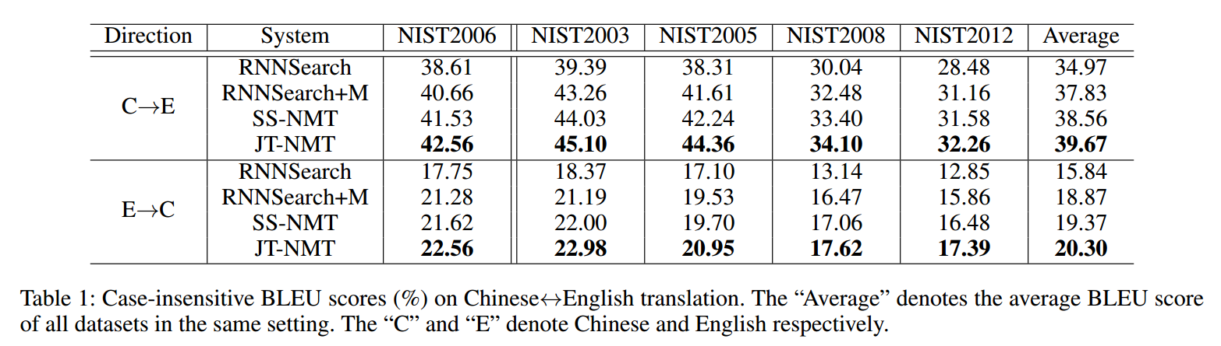
Experiment: Chinese-English Translation
NMT Overview | Iterative Back-Translation | Agreement Regularization | SMT as Posterior Regularization | Summary
Dataset
Bilingual data: 2.6M sentence pairs from LDC corpus
Monolingual data: 8M Chinese and English sentences extracted from Gigaword
Development data: NIST2006
Test data: NIST2003, NIST2005, NIST2008, NIST2012
Result

Slide 16
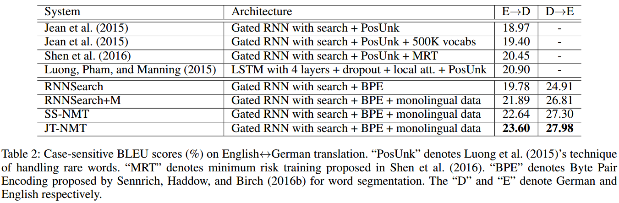
Experiment: English-German Translation
NMT Overview | Iterative Back-Translation | Agreement Regularization | SMT as Posterior Regularization | Summary
Dataset
Bilingual data: 4.5M sentence pairs from WMT 2014 training corpus
Monolingual data: 8M German and English sentences extracted from ”New Crawl: articles from 2012”
Development data: the concatenation of news-test 2012 and news-test 2013
Test data: news-test2014
Result

Slide 17
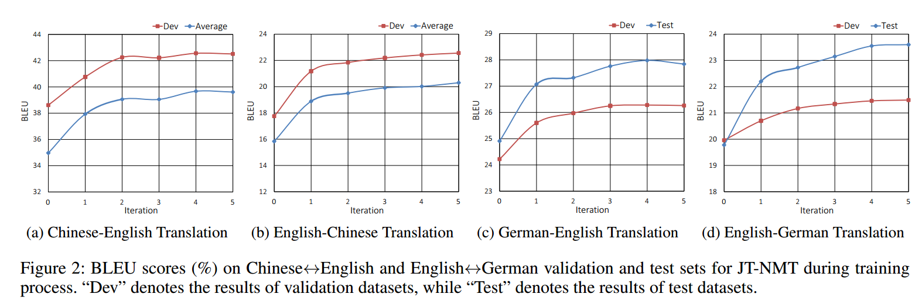
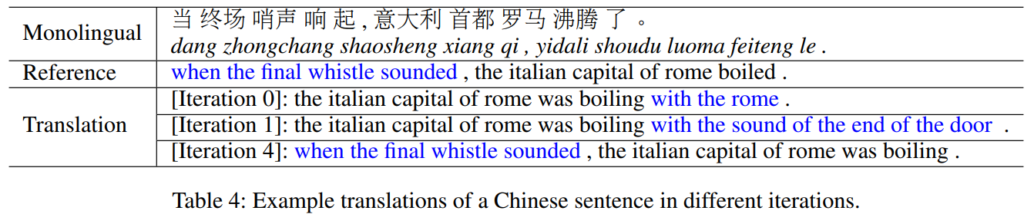
Effect of Iterative Training
NMT Overview | Iterative Back-Translation | Agreement Regularization | SMT as Posterior Regularization | Summary
Performance on every iteration

Slide 18
Motivation: Exposure Bias Problem
NMT Overview | Iterative Back-Translation | Agreement Regularization | SMT as Posterior Regularization | Summary
NMT model is only trained with golden bilingual sentences
Output sentence is auto-regressively generated word by word during decoding
Previous errors will mislead the generation of the subsequences
Errors will be quickly amplified
Training
Decoding

Slide 19


















Motivation: Exposure Bias Problem
NMT Overview | Iterative Back-Translation | Agreement Regularization | SMT as Posterior Regularization | Summary
Translate from Left to Right
Translate from Right to Left
Louis told KGO that Frank , who used to
Louis told KGO that Frank, who used to work as a cook in Boston, had found a job in a restaurant.
$$⊕$$
$$⊕$$
$$⊕$$
$$⊕$$
$$⊕$$
$$⊕$$
$$⊕$$
$$⊕$$
$$⊕$$
Louis 对 KGO 表示 , 之前 在 波士顿 做 厨师 的 Frank 在 旧金山 的 餐馆 找到 一 份 流水线 厨师 的 工作 .
. Francisco San in restaurant a at chef pipeline
Louis told KGO, had found a job as a pipeline chef at a restaurant in San Francisco .
$$⊕$$
$$⊕$$
$$⊕$$
$$⊕$$
$$⊕$$
$$⊕$$
$$⊕$$
$$⊕$$
$$⊕$$
Louis 对 KGO 表示 , 之前 在 波士顿 做 厨师 的 Frank 在 旧金山 的 餐馆 找到 一 份 流水线 厨师 的 工作 .

Slide 20
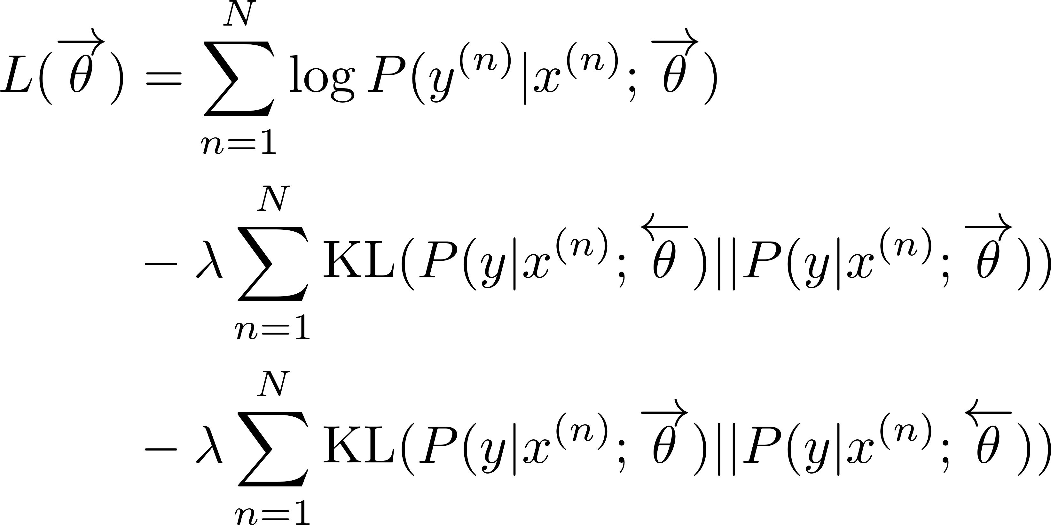
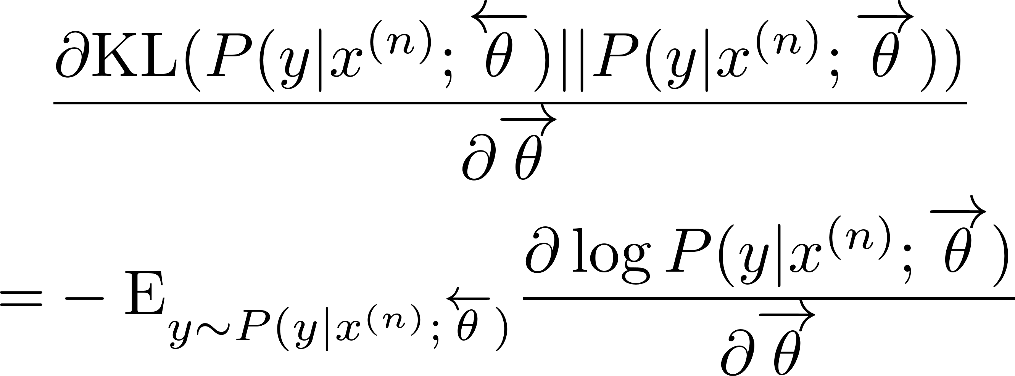
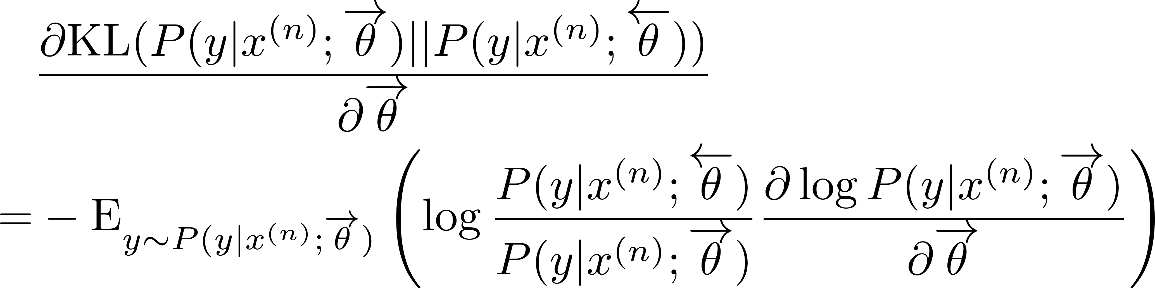
Target-bidirectional Agreement Regularization
NMT Overview | Iterative Back-Translation | Agreement Regularization | SMT as Posterior Regularization | Summary
Introduce two Kullback-Leibler (KL) divergence regularization terms
Weight

Slide 21
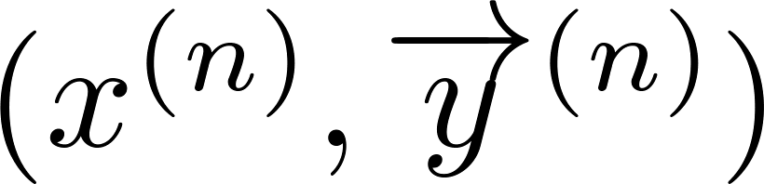
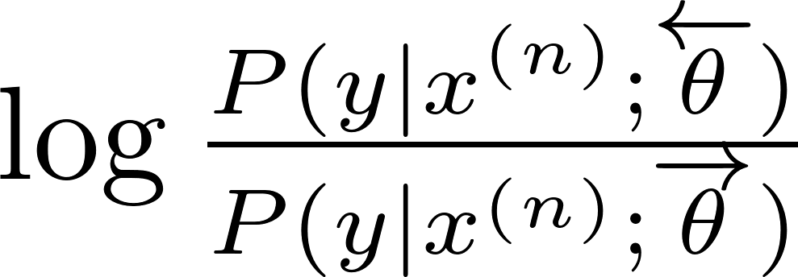
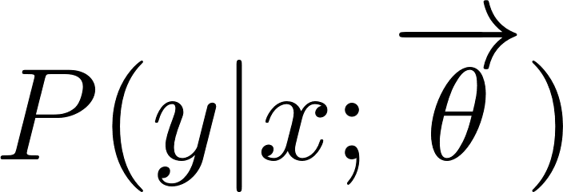
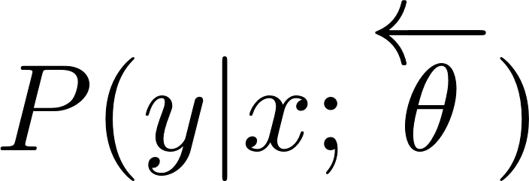
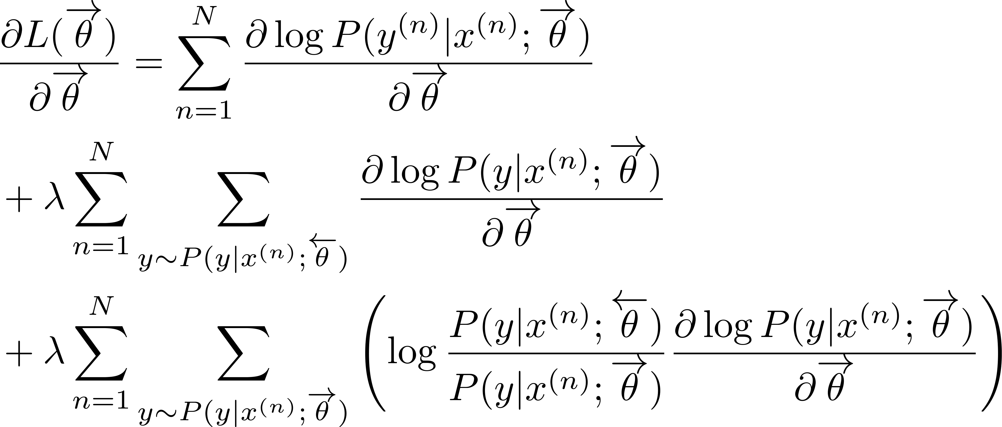
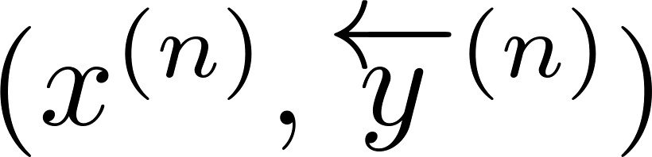
Agreement Regularization (R2L → L2R)
NMT Overview | Iterative Back-Translation | Agreement Regularization | SMT as Posterior Regularization | Summary
Pseudo Data
Sampling
Scoring
3
1
Bilingual Data
L2R Model
R2L Model
2
1
Sampling
2
Pseudo Data
3

Slide 22
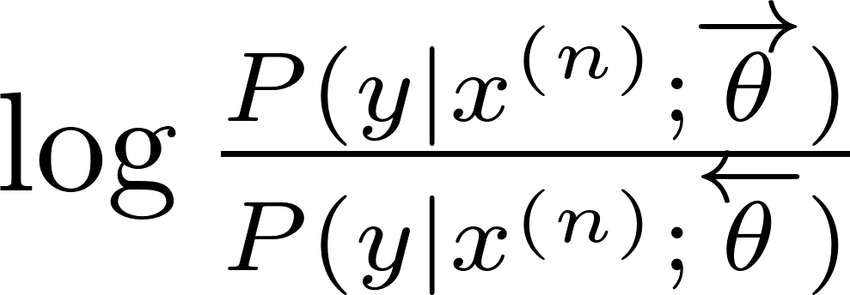

Agreement Regularization (L2R → R2L)
NMT Overview | Iterative Back-Translation | Agreement Regularization | SMT as Posterior Regularization | Summary
Pseudo Data
Sampling
Scoring
3
2
1
Bilingual Data
L2R Model
1
R2L Model
2
3
1
1
Scoring
Sampling
2
2
Pseudo Data
3
3

Slide 23
Agreement Regularization (Joint Training)
NMT Overview | Iterative Back-Translation | Agreement Regularization | SMT as Posterior Regularization | Summary
Pseudo Data
Sampling
Scoring
3
2
1
Bilingual Data
L2R Model
1
R2L Model
2
3
1
1
Scoring
Sampling
2
2
Pseudo Data
3
3

Slide 24
Experiment
NMT Overview | Iterative Back-Translation | Agreement Regularization | SMT as Posterior Regularization | Summary
Evaluate our approach on three datasets, including NIST OpenMT for Chinese-English, WMT17 for English-German and Chinese-English
NMT systems
Transformer: the-state-of-art NMT system (Vaswani et al. 2017)
Transformer + MRT: minimax risk training (Shen et al. 2016)
Transformer + JS: re-ranking the results from bidirectional models (Liu et al. 2016)
Transformer + RT: our method

Slide 25
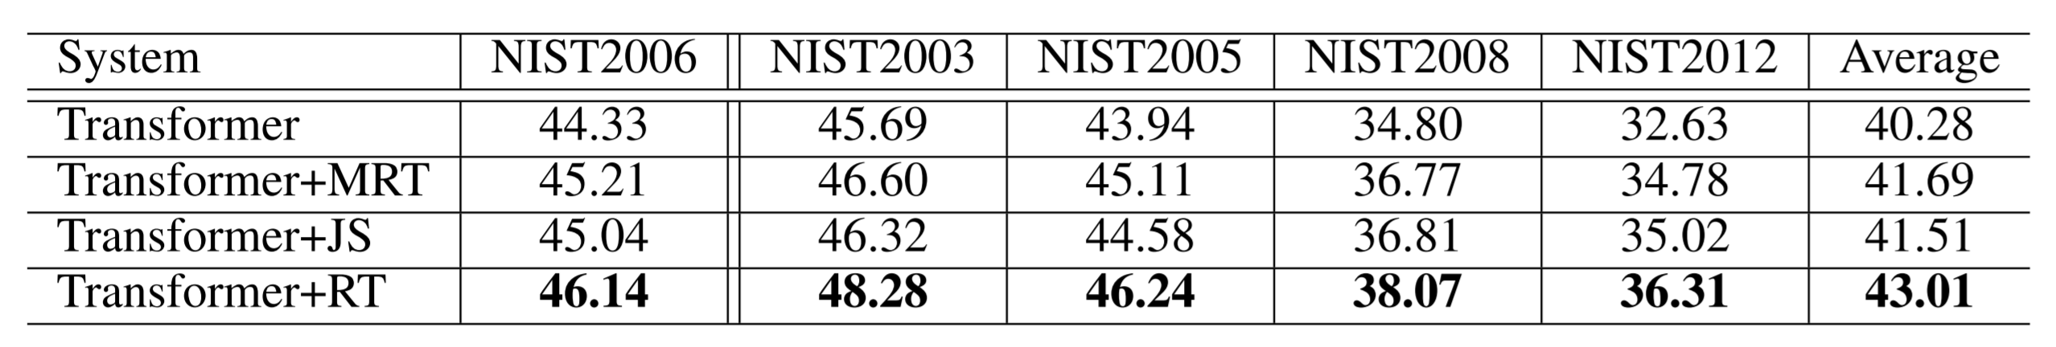
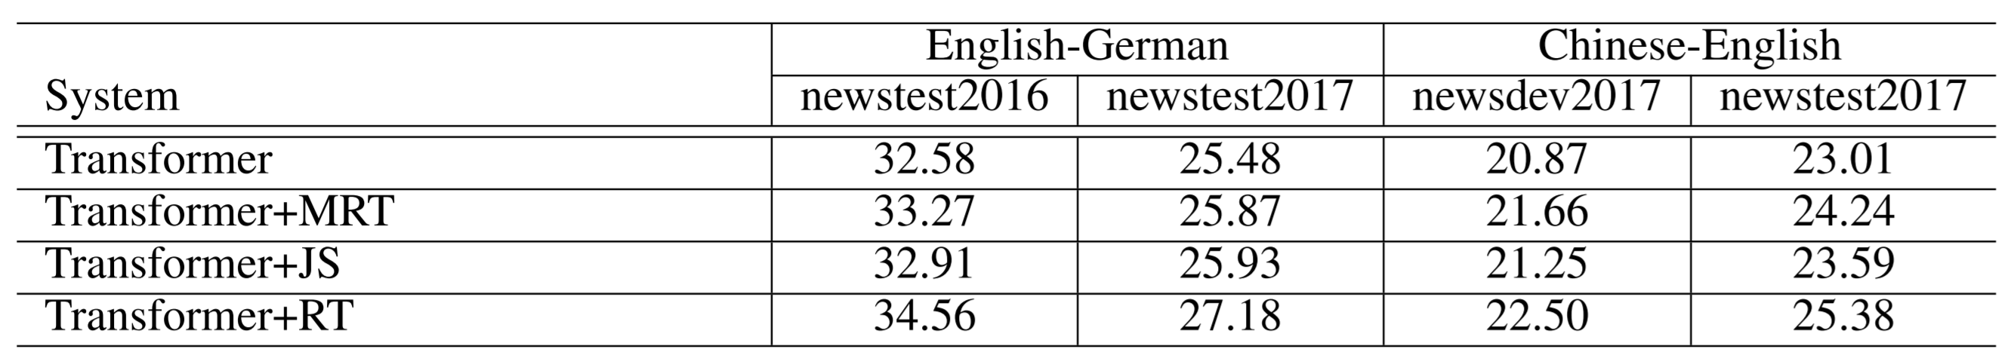
Experimental Result
NMT Overview | Iterative Back-Translation | Agreement Regularization | SMT as Posterior Regularization | Summary
Evaluation on NIST Corpora
Evaluation on WMT17 Corpora

Slide 26
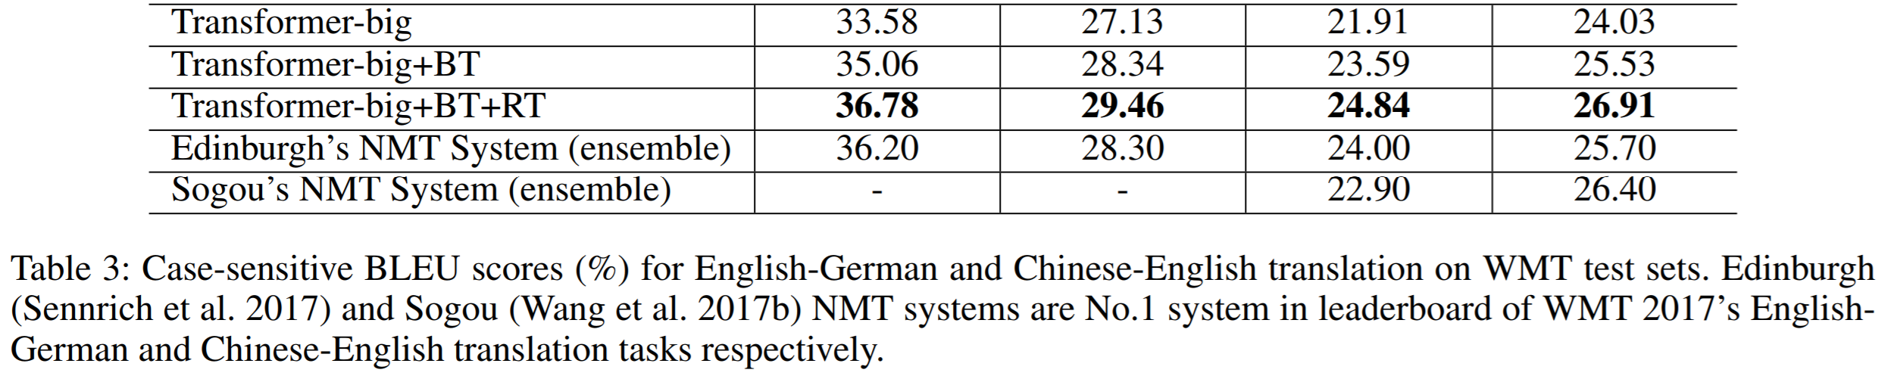
Combining with Back-Translation Method
NMT Overview | Iterative Back-Translation | Agreement Regularization | SMT as Posterior Regularization | Summary
Dataset
Monolingual data: randomly select 5M German sentences and 12M English sentences from “New Crawl: articles from 2016”
Result

Slide 27
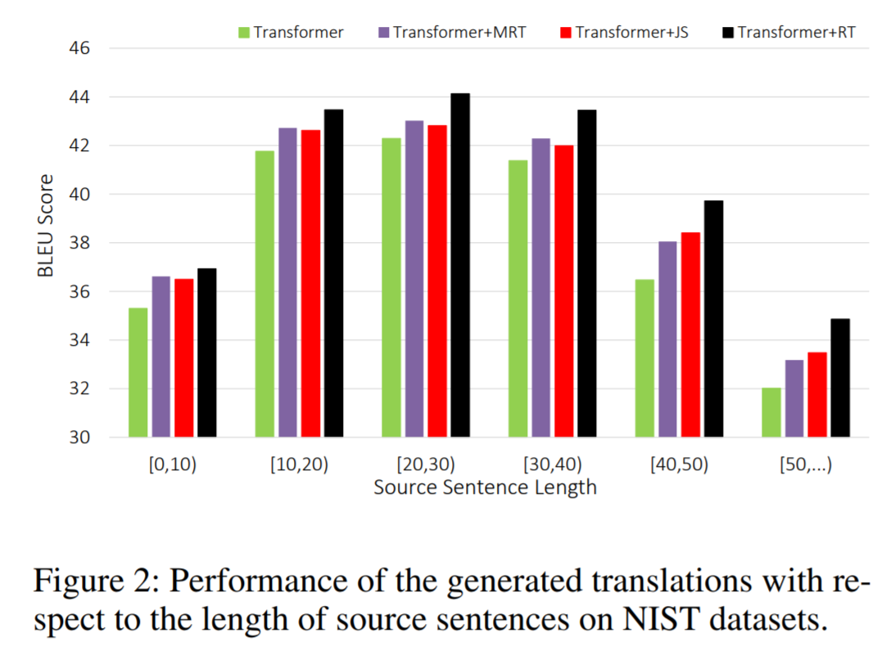
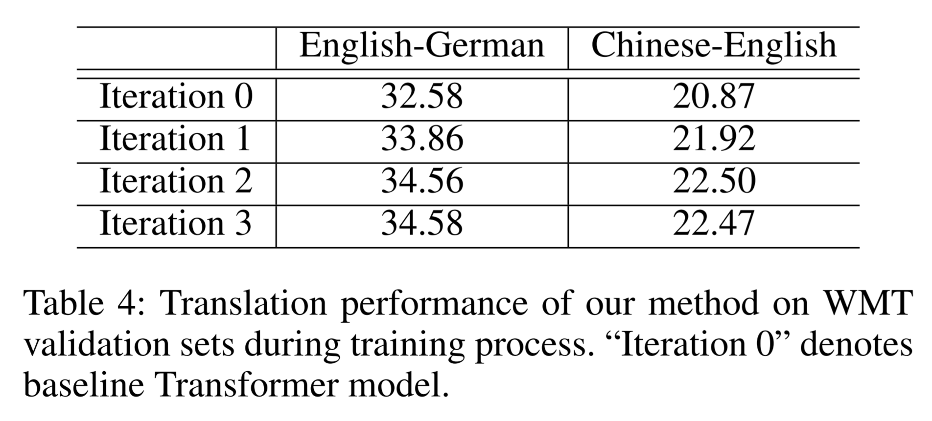
Analysis
NMT Overview | Iterative Back-Translation | Agreement Regularization | SMT as Posterior Regularization | Summary
Effect of Joint Training
Performance on Long Sentences

Slide 28
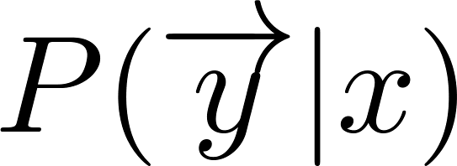
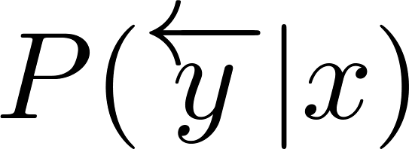
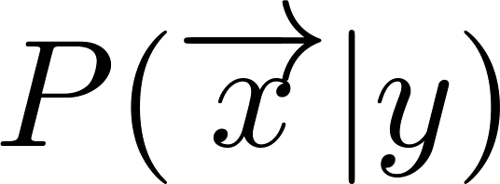
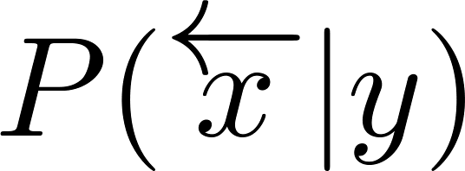

Iterative Back-Translation + Agreement Regularization
NMT Overview | Iterative Back-Translation | Agreement Regularization | SMT as Posterior Regularization | Summary
Training four models in an unified framework:
Generate Pseudo Data
Update T2S Models
Generate pseudo bilingual data with target monolingual corpus using T2S model
Update bidirectional T2S model with the pseudo data using agreement regularization
Update S2T Models
Generate Pseudo Data
Update bidirectional S2T model with the pseudo data using agreement regularization
Generate pseudo bilingual data with source monolingual corpus using S2T model

Slide 29
Iterative Back-Translation + Agreement Regularization
NMT Overview | Iterative Back-Translation | Agreement Regularization | SMT as Posterior Regularization | Summary
BLEU (%)
28.46(+System Combination)
28.5
27.71(+Iterative
Back-Translation)
28.0
27.5
26.91(+Agreement Regularization)
27.0
26.5
26.38(Sogou, Ensembel)
26.0
25.57(+Back-Translation)
25.5
25.0
24.5
24.0
24.2(Transformer Baseline)
Sep. Oct. Nov. Dec. Jan. Feb. Mar.

Slide 30
Iterative Back-Translation + Agreement Regularization
NMT Overview | Iterative Back-Translation | Agreement Regularization | SMT as Posterior Regularization | Summary
The core technique to achieve the new milestone
Achieve Human Parity on WMT2017 Chinese-to-English Translation Task (Hassan et al., 2018)
The two methods have used in Microsoft’s machine translation system
Tencent’s machine translation system in WMT18 Chinese-English Translation Task
LSTM-based System + Iterative Back-Translation + Agreement Regularization + Data selection
Rank 1 in Zh-En(single model), Zh-En(ensemble model) and En-Zh(single model)
Rank 4 in En-Zh(ensemble model)

Slide 31
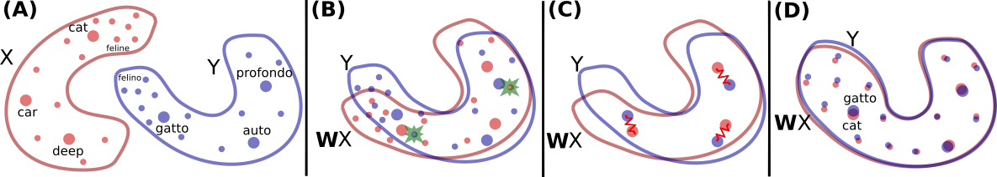
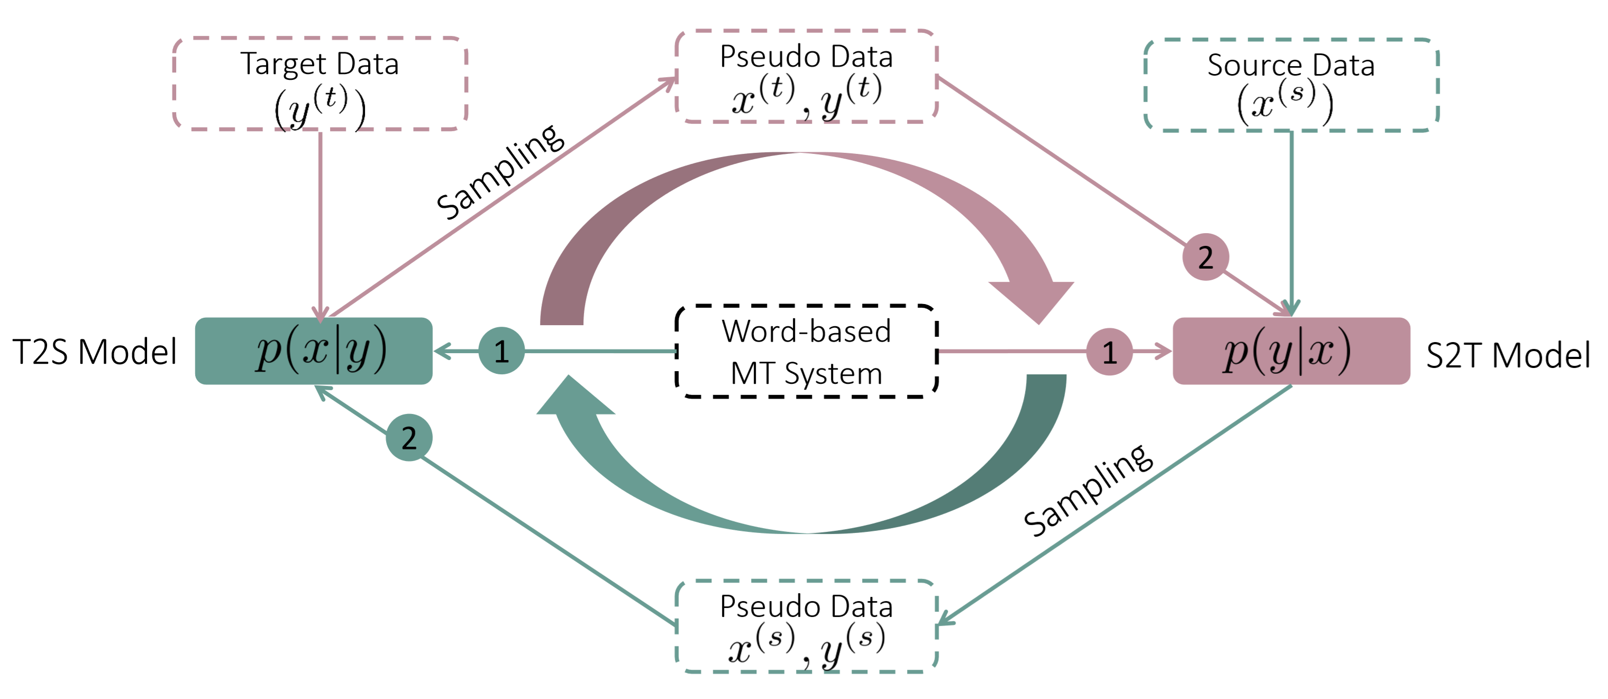
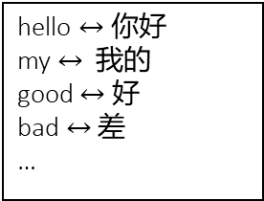
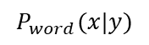
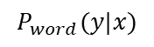
Unsupervised MT
NMT Overview | Iterative Back-Translation | Agreement Regularization | SMT as Posterior Regularization | Summary
Two main components of unsupervised MT
Model Initialization
Iterative Back-translation
Cross-lingual Word Embedding
hello $↔$ 你好
my $↔$ 我的
good $↔$ 好
bad $↔$ 差
…
Translation Table
$$P_{word}(y|x)$$
Word-based MT System
$$P_{word}(x|y)$$

Slide 32
Motivation
NMT Overview | Iterative Back-Translation | Agreement Regularization | SMT as Posterior Regularization | Summary
Noisy pseudo data generated with back-translation method
Bad pseudo sentence pairs hurt the performance.
Due to weak supervision, noises and errors will be accumulated and reinforced.
SMT performs better than NMT in tackling noisy data

Slide 33




Posterior Regularization
NMT Overview | Iterative Back-Translation | Agreement Regularization | SMT as Posterior Regularization | Summary
Posterior regularization [Ganchev et al. 2010] can incorporates indirect supervision from a desired distribution $q(y)$ via constraints on posterior distribution $p(y|x_{n};θ)$:
$Q$ is a constraint posterior set satisfying:
Update models via EM framework:

Slide 34



SMT as Posterior Regularization
NMT Overview | Iterative Back-Translation | Agreement Regularization | SMT as Posterior Regularization | Summary
Leverage SMT to denoise and guide the training of unsupervised NMT models in the iterative back-translation process
We replace the posterior regularization term $q(y)$ with the SMT models ($\vec{p_{s}}\left(y | x;θ_{x→y}\right)$ and $\overset{⃖}{p_{s}}(x|y;θ_{y→x})$):

Slide 35


EM Training Algorithm
NMT Overview | Iterative Back-Translation | Agreement Regularization | SMT as Posterior Regularization | Summary
E Steps: Optimize SMT models to minimize the KL distance between SMT models and NMT models
M Steps: Optimize NMT models using the pseudo data generated by SMT models and the corresponding reverse NMT models

Slide 36





Model Initialization
NMT Overview | Iterative Back-Translation | Agreement Regularization | SMT as Posterior Regularization | Summary
Target Data
Source Data
Cross-lingual Word Embedding
Language Model
Language Model
Word pair ||| p(x|y) ||| p(y|x)
hello $↔$ 你好 ||| 0.876 ||| 0.686
my $↔$ 我的 ||| 0.43 ||| 0.342
…
${SMT}_{0}$($x→y$)
Word Translation Table
${SMT}_{0}$($y→x$)
Pseudo Data
${NMT}_{0}$($x→y$)
${NMT}_{0}$($y→x$)
Pseudo Data

Slide 37




SMT as Posterior Regularization (E-steps)
NMT Overview | Iterative Back-Translation | Agreement Regularization | SMT as Posterior Regularization | Summary
Target Data
Noisy Pseudo Data
$SMT$($y→x$)
Sampling
$NMT$($y→x$)
$NMT$($x→y$)
Sampling
$SMT$($x→y$)
Noisy Pseudo Data
Source Data

Slide 38
SMT as Posterior Regularization (M-steps)
NMT Overview | Iterative Back-Translation | Agreement Regularization | SMT as Posterior Regularization | Summary
Sampling
Target Data
Noisy Pseudo Data
$SMT$($y→x$)
Denoised Pseudo Data
Sampling
2
1
$NMT$($y→x$)
$NMT$($x→y$)
1
Sampling
2
Denoised Pseudo Data
$SMT$($x→y$)
Noisy Pseudo Data
Source Data
Sampling

Slide 39

Experiment
NMT Overview | Iterative Back-Translation | Agreement Regularization | SMT as Posterior Regularization | Summary
Dataset
Monolingual data: Following the setting in [Lample et al. 2018], select 50M English, French and German sentences in NewsCrawl
Test data
English-French translation task: news-test 2014
English-German translation task: news-test 2014 and 2016
Result
Supervised MT:
en-fr: 41.8
en-de(2014): 28.4

Slide 40

Example
NMT Overview | Iterative Back-Translation | Agreement Regularization | SMT as Posterior Regularization | Summary

Slide 41
Summary
NMT Overview | Iterative Back-Translation | Agreement Regularization | SMT as Posterior Regularization | Summary
We provide the theory foundation for back-translation and design the iterative version to better leverage monolingual data
We use target-bidirectional agreement constraints to address the exposure bias problem
We introduce SMT models as posterior regularization to guide the training of unsupervised NMT models

Slide 42
Publications
NMT Overview | Iterative Back-Translation | Agreement Regularization | SMT as Posterior Regularization | Summary
Zhirui Zhang, Shujie Liu, Mu Li, Ming Zhou and Enhong Chen, Joint Training for Neural Machine Translation Models with Monolingual Data, AAAI-18. (Iterative Back-Translation)
Zhirui Zhang, Shuangzhi Wu, Shujie Liu, Mu Li, Ming Zhou and Enhong Chen, Regularizing Neural Machine Translation by Target-bidirectional Agreement, submit to AAAI-19. (Agreement Regularization)
Zhirui Zhang*, Ren Shuo*, Shujie Liu, Mu Li, Ming Zhou and Shuai Ma, Unsupervised Neural Machine Translation with SMT as Posterior Regularization, submit to AAAI-19. (SMT as Posterior Regularization)

Slide 43
Publications
NMT Overview | Iterative Back-Translation | Agreement Regularization | SMT as Posterior Regularization | Summary
Zhirui Zhang, Shujie Liu, Mu Li, Ming Zhou and Enhong Chen, Bidirectional Generative Adversarial Networks for Neural Machine Translation, CoNLL 2018.
Shuangzhi Wu, Dongdong Zhang, Zhirui Zhang, Nan Yang, Mu Li and Ming Zhou, Dependency-to-Dependency Neural Machine Translation, IEEE Transactions TASLP-18.
Zhirui Zhang, Shujie Liu, Mu Li, Ming Zhou and Enhong Chen, Coarse-To-Fine Learning for Neural Machine Translation, NLPCC 2018.
Wenhu Chen, Guanlin Li, Shuo Ren, Shujie Liu, Zhirui Zhang, Mu Li and Ming Zhou, Generative Bridging Network in Neural Sequence Prediction, NAACL 2018.
Duyu Tang, Nan Duan, Zhao Yan, Zhirui Zhang, Yibo Sun, Shujie Liu, Yuanhua Lv and Ming Zhou, Learning to Collaborate for Question Answering and Asking, NAACL 2018.
Zhirui Zhang, Shujie Liu, Mu Li, Ming Zhou and Enhong Chen, Stack-based Multi-layer Attention for Transition-based Dependency Parsing, EMNLP 2017.

Slide 44
Preprints
NMT Overview | Iterative Back-Translation | Agreement Regularization | SMT as Posterior Regularization | Summary
Hany Hassan, Anthony Aue, Chang Chen, Vishal Chowdhary, Jonathan Clark, Christian Federmann, Xuedong Huang, Marcin Junczys-Dowmunt, William Lewis, Mu Li, Shujie Liu, Tie-Yan Liu, Renqian Luo, Arul Menezes, Tao Qin, Frank Seide, Xu Tan, Fei Tian, Lijun Wu, Shuangzhi Wu, Yingce Xia, Dongdong Zhang, Zhirui Zhang and Ming Zhou, Achieving Human Parity on Automatic Chinese to English News Translation, 2018.
Zhirui Zhang*, Shuo Ren*, Shujie Liu, Jianyong Wang, Peng Chen, Mu Li, Ming Zhou and Enhong Chen, Style Transfer as Unsupervised Machine Translation, 2018.
Wenhu Chen, Guanlin Li, Shujie Liu, Zhirui Zhang, Mu Li, Ming Zhou, Approximate Distribution Matching for Sequence-to-Sequence Learning, 2018.

Slide 45
Thank you!
Q & A

